Slide 1
Introduction to PHP

Slide 2
PHP Basics
The PHP code is enclosed in special start and end processing instructions <?php and
?> that allow you to jump into and out of "PHP mode."
PHP code is executed on the server, generating HTML which is then sent to the client. The client would receive the results of running that script, but would not know what the underlying code was.

Slide 3
PHP: Hello World
index.php on the server
What shows up in the browser
<!doctype html>
<html>
<head>
<title>PHP Hello World!</title>
</head>
<body>
<?php
echo "Hello World!"; print "<br>";
echo "Welcome!";
?>
</body>
</html>
Hello World! Welcome!
Client sees this as source of the page
<!doctype html>
<html>
<head>
<title>PHP Hello World!</title>
</head>
<body>
Hello World!<br>Welcome!
</body>
</html>

Slide 4
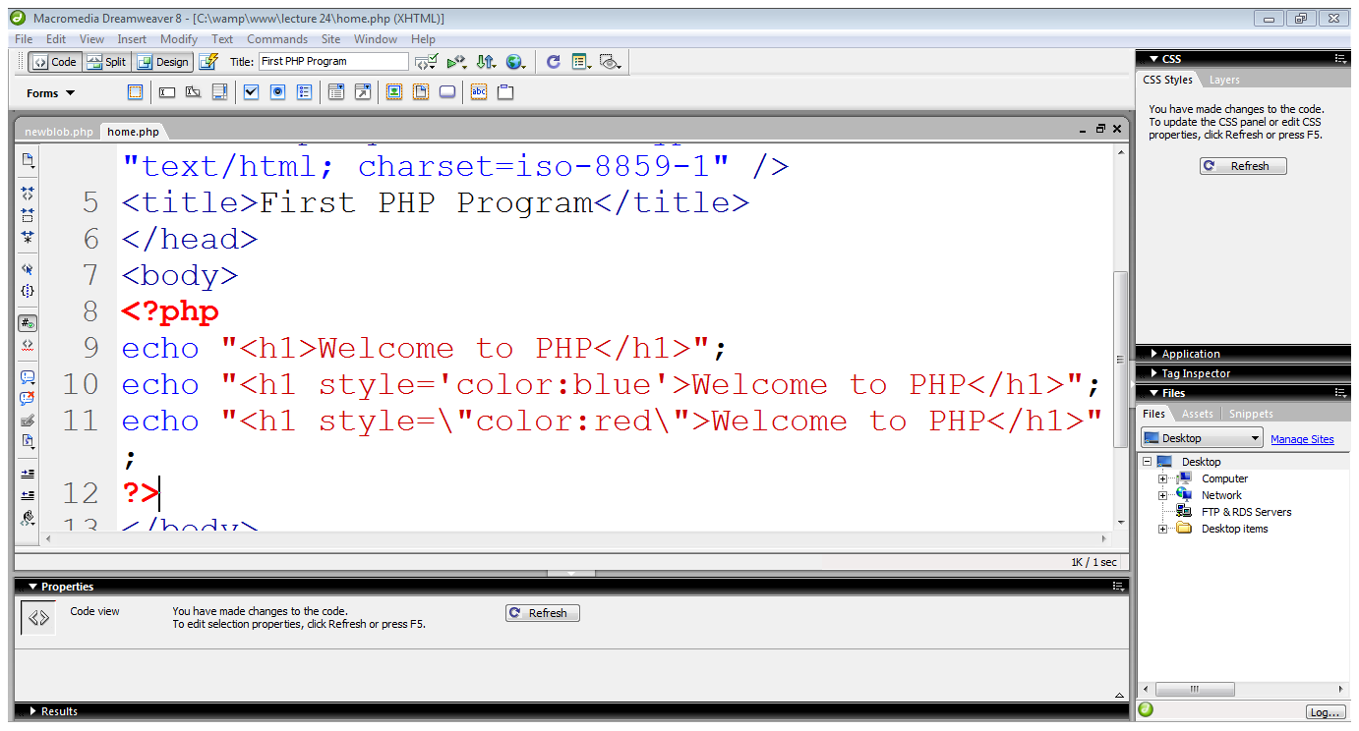
Integrating HTML with PHP
echo statement outputs whatever it’s told to the browser
It can output not only plain text but also HTML tags
echo “<h1> Welcome to the PHP</h1>”;

Slide 5
PHP Variables
A variable is a place to store values
When you first create a variable, it does not have a value (it is null). You can set a value for a variable.
Variables can hold different types of information, like words, numbers, and collections of data.
The value of a variable can change over time.

Slide 6
PHP Variables
To create a variable, just type a dollar sign and the variable name. PHP will create the variable for you.
$age;
It is a good idea to give your variable a starting value. This is called initializing the variable.
$age = 5;
Once you have created a variable, you can use it in your code. Just type a dollar sign and the name of the variable
$age = 5; echo $age;

Slide 7
PHP Variable Values: Numbers
Variables can be numbers, either integers or floats (decimals).
$numberOfCoffees = 4;
$coffeePrice = 2.3;
PHP will automatically convert integers to floats if needed. Once you have numbers, you can do math with them!
$totalPrice = $numberOfCoffees * $coffeePrice;

Slide 8
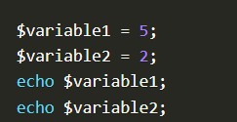
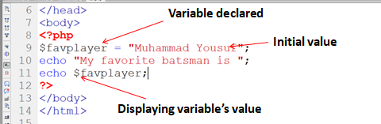
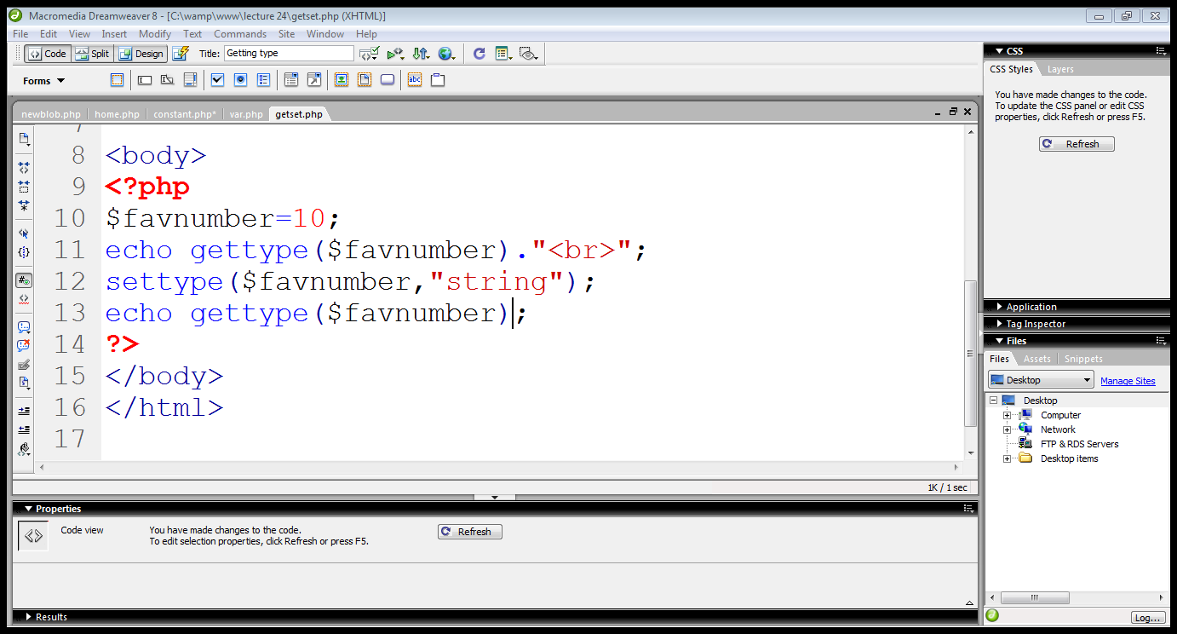
variables

Slide 9
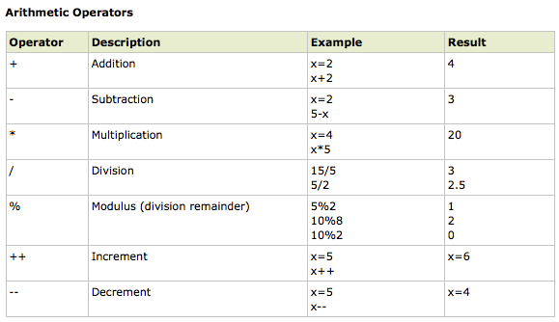
PHP Operators

Slide 10
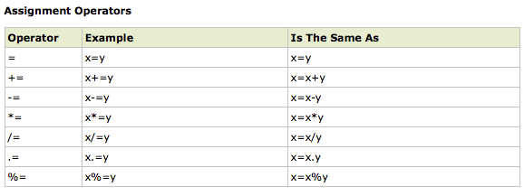
PHP Operators

Slide 11
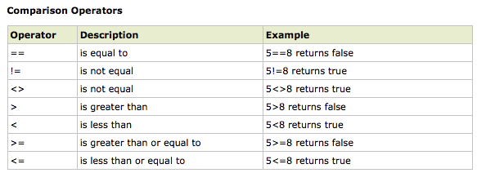
PHP Operators

Slide 12
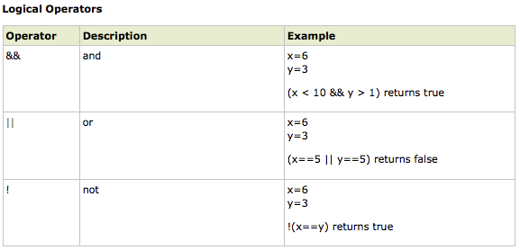
PHP Operators

Slide 13
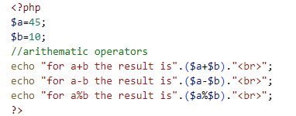
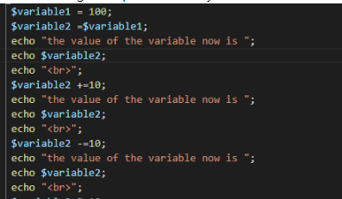

Slide 14
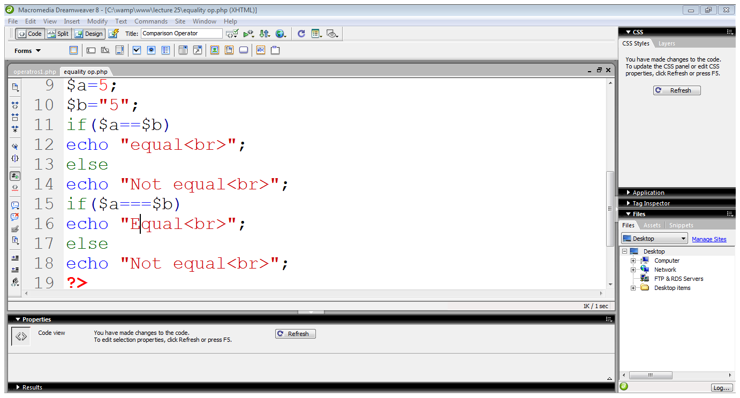
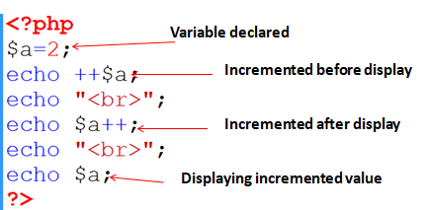
Operators in PHP…
Integer value
String value
Compares only values
Strict comparison

Slide 15
PHP String Operators
You can put strings together with a period, the concatenation operator.
$firstName = 'Fluffy';
$fullName = $firstName . ' McDougle';
echo $fullName; //Outputs 'Fluffy McDougle'
You can also use .= to add things to the end of a string.
$name = 'Fluffy';
$name .= ' McDougle';
echo $name; //Outputs 'Fluffy McDougle'

Slide 16
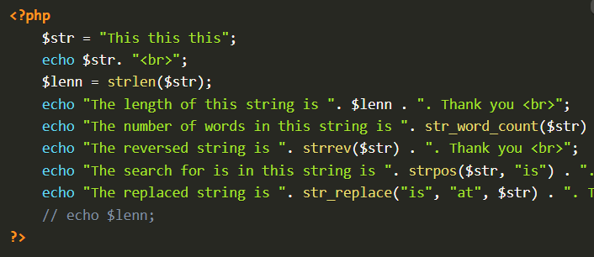
Php string functions

Slide 17
PHP Conditional Statements
Very often when you write code, you want to perform different actions for different decisions.
You can use conditional statements in your code to do this. In PHP we have the following conditional statements...

Slide 18
PHP Conditional Statements
if...elseif....else statement - use this statement to select one of several blocks of code to be executed
<!doctype html>
<html>
<body>
<?php
$d = date("D");
if ($d == "Fri")
echo "Have a nice weekend!"; elseif($d == "Sun")
echo "Have a nice Sunday!"; else
echo "Have a nice day!";
?>
</body>
</html>

Slide 19
PHP Function Parameters
To add more functionality to a function, we can add parameters. A parameter is just like a variable.
Parameters are specified after the function name, inside the parentheses.
<!doctype html>
<html>
<body>
<?php
function callMeByMyName($name)
{
echo 'Hey ' . $name;
}
callMeByMyName('Peter');
$someName = 'Donald'; callMeByMyName($someName);
?>
</body>
</html>
Output: Hey Peter Hey Donald

Slide 20
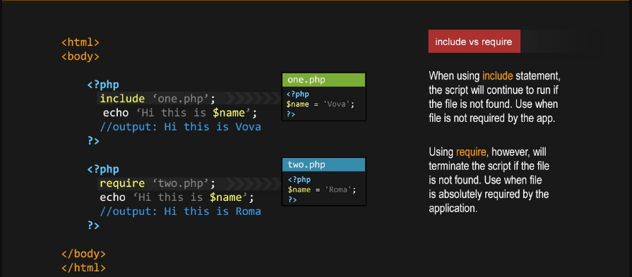
Include vs require in php

